Slide 1
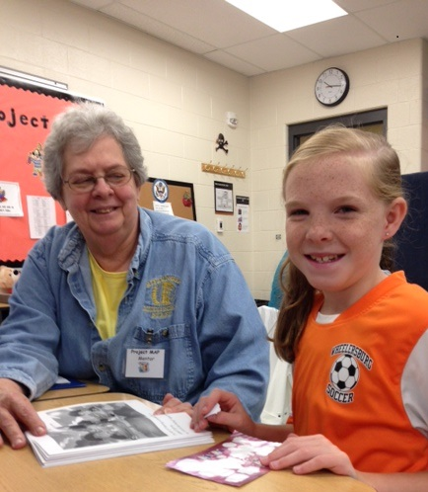
Learning About the M4RA Mentoring Program
1.30.15

Slide 2
Is a statewide, non-profit organization
dedicated to advancing the
educational interests of children
with disabilities since 1972.
Offers free in-service trainings for
parents and professionals in Ohio
on advocacy and educational topics.

Slide 3
What is M4RA?
The Mentoring 4 Reading Achievement Program (M4RA)
is the coming together of parents, schools and volunteers to support reading achievement for all students who struggle in reading.
  1:1 reading mentoring for students reading below grade level
  30 minute sessions 4 times per week—before, during, or after school

Slide 4
What is the school’s mentoring program?
Provides 1:1 reading mentoring for students identified in the Program’s Entrance Criteria
Provides mentoring as often as possible. Research supports 4 X per week
Pre-tests and post-tests students using DIBELS, DRA, aimsweb®, etc.; or fluency passages
Uses mentoring materials from www.readinga-z.com

Slide 5

GOALS FOR TODAY’S TRAINING
To familiarize participants with 1 to 1 mentoring
To understand the roles and responsibilities of mentors
To practice activities in a typical mentoring session

Slide 6

WHO MENTORS?
Parent volunteers
Student volunteers
Community volunteers
College students
Teachers
School aides, Para-pros, Bus Drivers, Cooks, other staff

Slide 7

ROLES OF THE MENTOR
Sign a Mentor Contract
Be dependable. Adhering to the schedule is essential.
Be on time!
Follow the plans
Write comments about the session
Maintain confidentiality
Maintain records: tracking forms, progress report as required

Slide 8

WHAT TO EXPECT
Lesson Plan for each mentoring session = “What to do?”
Created by the Coordinator
Followed by the Mentor
Mentor records comments
Notes:
Review sample lesson plan
Show Mentor Comments bookmarks

Slide 9
WHO ARE YOU?
Discussion Questions for the Mentor & Mentee
Initial week’s activities (every time a new mentor or student is added)
Building relationships between the Mentor and the Student
Sharing interests and learning more about each other
  Examples:
  • What is your favorite game to play?
  • If you could be any type of sandwich what would you be and why?
  • What is your favorite thing to do outside?

Slide 10
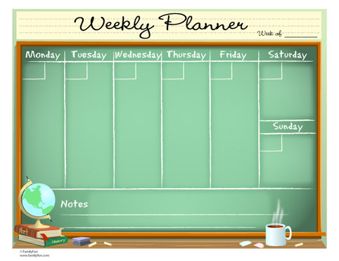
THE SESSION PLAN
Completion of FLUENCY work
(cold, warm, hot)
Completing Graphic Organizer
Motivation and tracking of progress
(stickers, graphs, games)
Demonstration of knowledge of skills through the game(s)
Completion of writing activities
Achievement of a passing score on Comprehension Quick Check

Slide 11
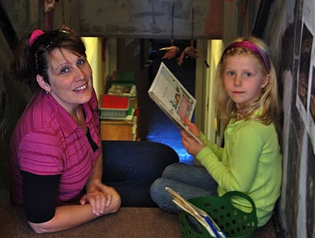
TYPES OF READING TO EXPECT
Read Aloud: Mentor reads the story first
Shared Reading: Taking turns
Guided Reading: Listening to student read

Slide 12

COMPONENTS OF READING
Alphabet Recognition
Phonological Awareness
Word Recognition
High Frequency Words
Fluency
Comprehension Questioning
Comprehension Strategies
See Readinga-z.com “Tips for Teaching”

Slide 13
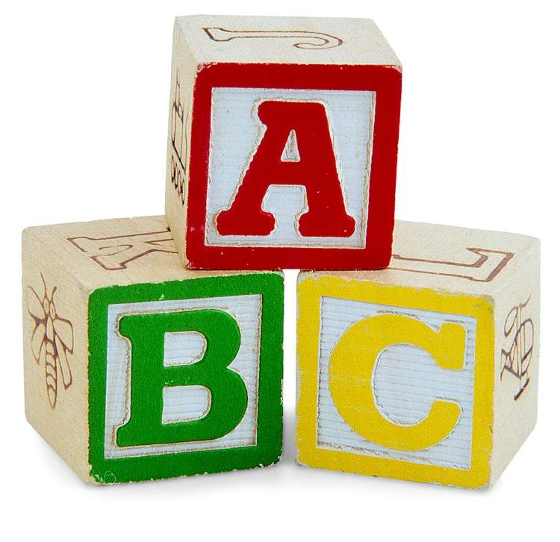
ALPHABET RECOGNITION
Alphabet assessments will determine a student’s ability in alphabet letter recognition
Practice identifying and writing upper and lower case letters

Slide 14

PHONOLOGICAL AWARENESS
Phonemic awareness assessments will determine a student’s ability to hear sounds
Rhyme
Isolating and categorizing sounds
Blending and segmenting syllables
and sounds
Manipulating phonemes (sounds)

Slide 15
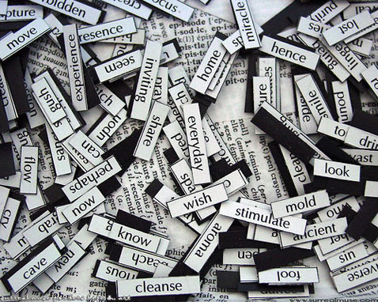
WORD RECOGNITION
Sound out the word
Use picture clues
Look for word chunks
Apply common phonics rules
Recognize syllable patterns

Slide 16
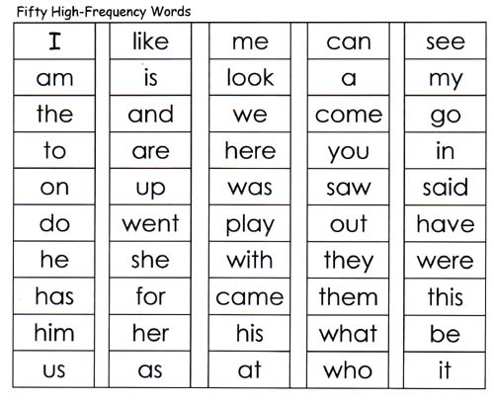
HIGH FREQUENCY WORDS
13 words make up 25% of the words we read
100 words make up 50% of words we read
Students need to be able to recognize these words automatically without sounding them out in order to be fluent

Slide 17

THE IMPORTANCE OF FLUENCY
Speed -- standard reading rate
Prosody -- proper pause and expression
Allows students to focus on getting the meaning from text
Fluent readers automatically recognize words accurately and effortlessly.
Fluent readers group words into phrases and chunks as they read with expression and fluidity.
Notes:
Frequently Asked Questions Page 36 Project MORE notebook

Slide 18
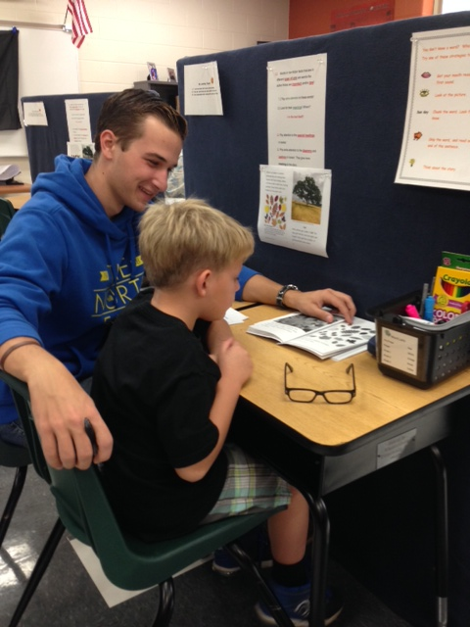
COMPREHENSION
Understanding what is read:
Questioning
Predicting
Visualizing
Retelling and summarizing
Connections to life, other texts, prior knowledge
Notes:
Tips for Teaching
Mentoring Reminders bookmark

Slide 19
Let’s make books!
Make Alphabet Book Letter S (vertical)
Make Ocean Animals Book (horizontal)

Slide 20

LET’S LOOK AT THE FOLDER
Notes:
Walk participants through contents of folder

Slide 21
a. Cards, game pieces, stickers, etc.
b. Mentor Helps
c. Game Board (www.readinga-z.com)
d. Progress Report
e. Calendar to track the mentoring sessions
f. Mentor Instructions for Fluency
g. Fluency Passages
h. Fluency Graph
i. Book (www.readinga-z.com)
j. Lesson Plans (www.readinga-z.com) including vocabulary cards, Graphic Organizer, Comprehension Quick Check, etc.

Slide 22
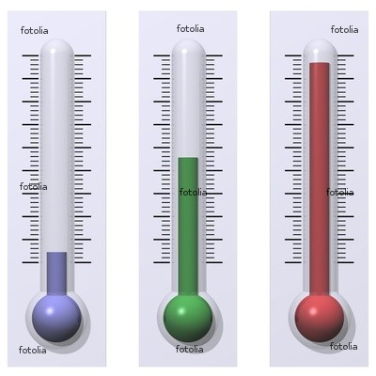
WHAT TO EXPECT: FLUENCY
Cold Read
  Every time a student is given a “new book”!
  One minute timed reading of a fluency passage
  Mentor tracks errors in BLUE
Warm Read
  Also during the “new book” lesson
  Student practices passage with mentor support
  One minute timed reading
  Mentor tracks errors in YELLOW
Hot Read
  2nd—4th sessions used to practice
  5th session one minute timed reading (same passage)
  Mentor tracks errors in RED
  STUDENTS CREATE BAR GRAPH TO TRACK PROGRESS
Notes:
Project MORE notebook page 29

Slide 23
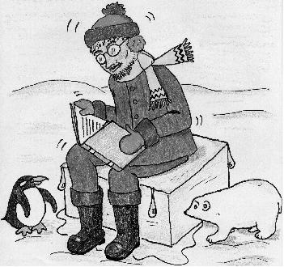
LET’S PRACTICE: FLUENCY
Use the mentoring folders
With a partner, agree who will be the “student” and who will be the “mentor”
Do a COLD READ
(student reads/mentor marks errors)
Graph the results
Practice
Do a WARM READ
(student reads/mentor marks errors)
Graph the results

Slide 24
What is a Bar Graph?
Look at the Reading Fluency Graph (85 wpm).
A bar graph is a visual way to compare information that involves numbers.
The title of the graph helps us know what information the bar graph is displaying. This graph tracks the Cold, Warm and Hot timed fluency reads a student made.
Along the bottom of the graph are the dates, the titles of the books, fiction (f: not true) or nonfiction (nf: true) and the books’ levels. This information is called the x-axis.
The numbers along the left side are called the y-axis. These numbers show the number of words read correctly in a minute (wpm).

Slide 25
LET’S PRACTICE:
Fluency & Comprehension Activities
Follow the Multi-Session Fluency & Comprehension Lesson
Plan (With a partner, choose the “student” and the “mentor”)
Fluency Instruction for Mentors
Cold Read, Practice & Warm Read
Fill in the Fluency Graph with the Student
Read through Lesson 1, Part 2
Do the activities with the book
Practice : Added Vocabulary Words
Play Game

Slide 26
LET’S PRACTICE:
ALPHABET RECOGNITION
Tutor Teaching Tips handout from Alphabet Pack: Letter Ss
Look at Alphabet Lesson Plan (in handouts)
Discuss Day 1: 1., 2., 3., Alphabet Graph (in handouts)
Role Play 4., 5. “Introduce the Letter S”

Slide 27


QUESTIONS and NEXT STEPS

